Slide 1
Tidy Data and Efficient Data Wrangling
Michael Otterstatter
BCCDC Biostats Session
Jan 18, 2019

Slide 2
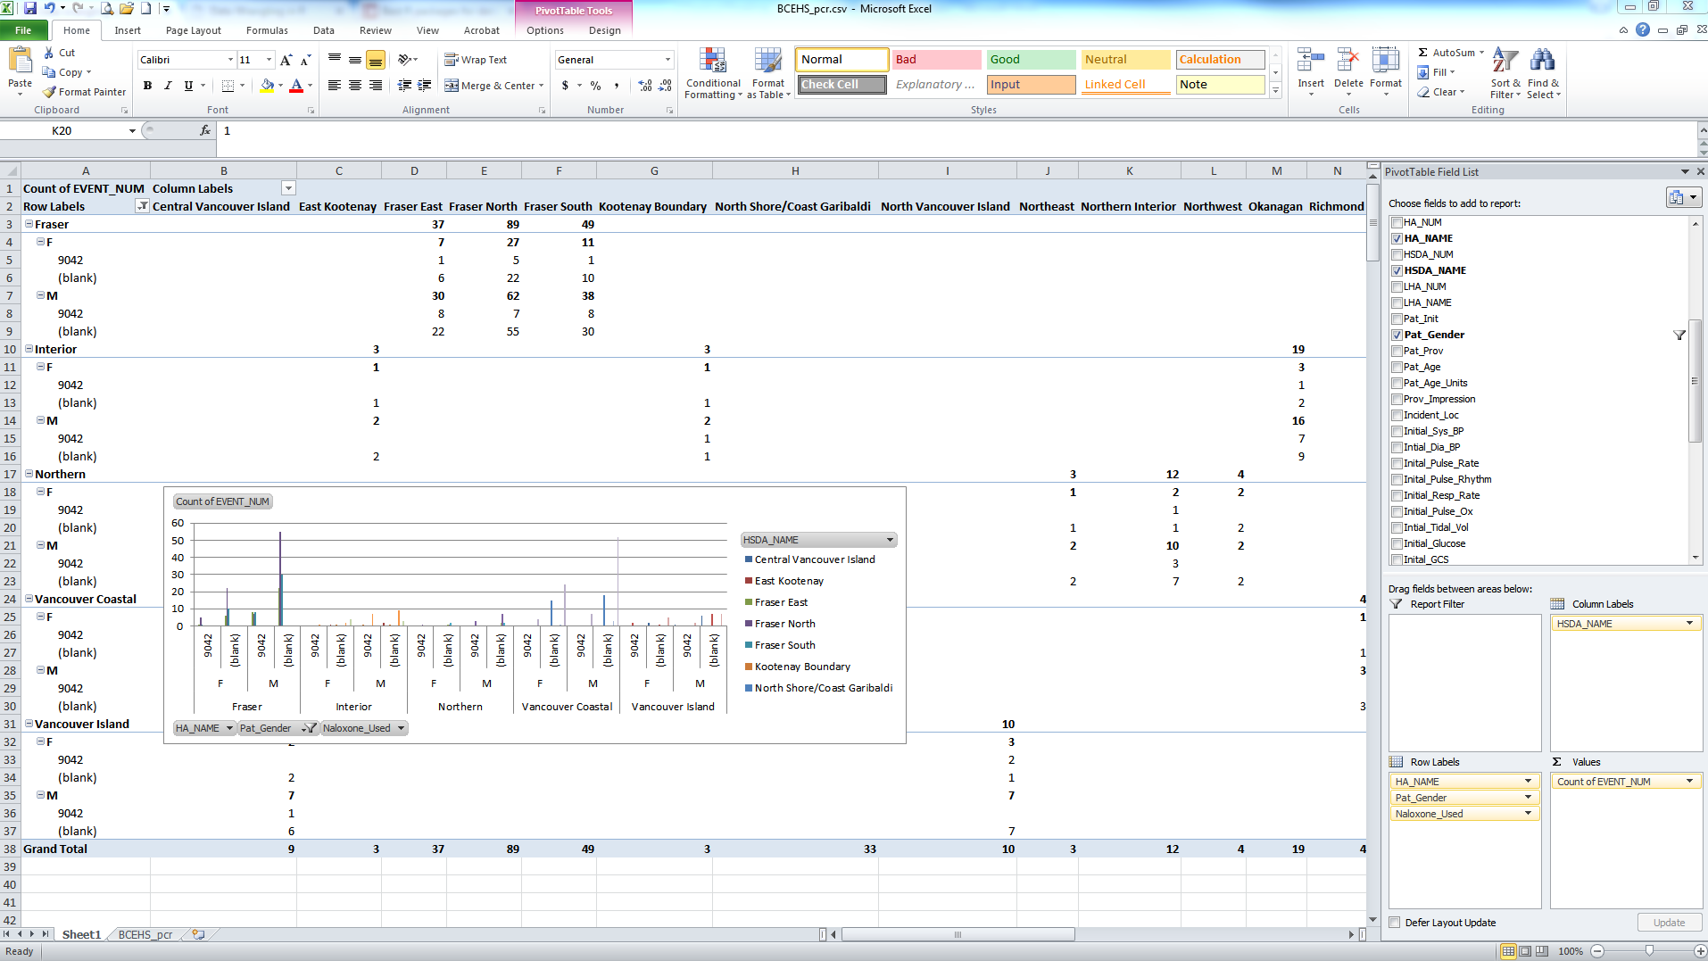

Messy data
Health datasets are typically too large and complex to be efficiently handled in spreadsheets

Slide 3
‘Wrangling’ messy data
Data wrangling: process of converting raw data into a format allowing convenient ‘consumption’, including visualization, aggregation, statistical modeling, etc.
The process typically follows general steps beginning with importing raw data and then "munging" these data using algorithms (e.g., sorting) or parsing the data into predefined data structures.
https://en.wikipedia.org/wiki/Data_wrangling

Slide 4

Data wrangling
‘Wrangling’ messy data
Efficient ‘wrangling’ or ‘munging’ of large/messy data requires
powerful software, e.g.,
data management / programming (e.g., SQL)
statistical packages (e.g., SAS, R, etc.)
a framework for data manipulation
fly by the seat of your pants?
tidy data

Slide 5
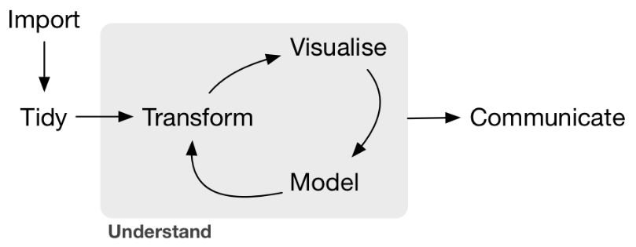
Tidy data
A foundational activity in the analysis of health data is creating a tidy dataset
Tidy data are clean, efficient and ready for visualization, linkage and analysis
http://jules32.github.io/2016-07-12-Oxford/dplyr_tidyr/#

Slide 6
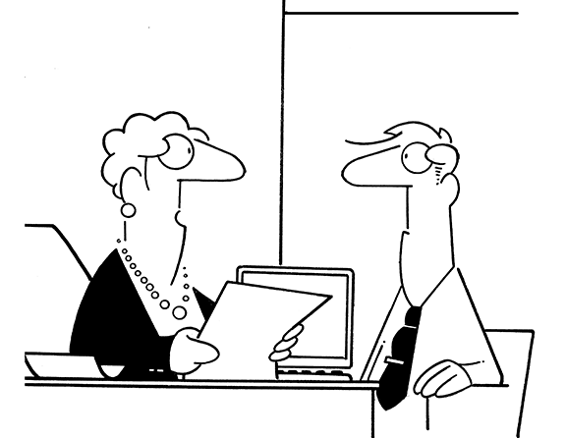
Not tidy ☹
“I need these summarised by age group.”

Slide 7
Not tidy ☹
“I changed my mind. I need these summarised by Health Authority.”

Slide 8

Tidy data
Basic structure of tidy data
each variable is saved in its own column
each observation (individual, or other unit) is saved in its own row
data cells contain values of variables

Slide 9
Tidy ☺

Slide 10
Tidy ☺
Variables as columns

Slide 11
Tidy ☺
Observation units as rows

Slide 12
Tidy ☺
Data cells are values of variables

Slide 13
Why Tidy?
General benefit: a consistent way of structuring/storing data, making it easier to learn tidy data tools. These tools work consistently with tidy data because of their standardized structure
Specific benefit: variables as columns allows efficient use of R, which typically functions by using vectors of values

Slide 14





Tidy data
Principles of tidy data apply regardless of whether you use SAS, R, Stata, SPSS, or Excel (god help you)

Slide 15
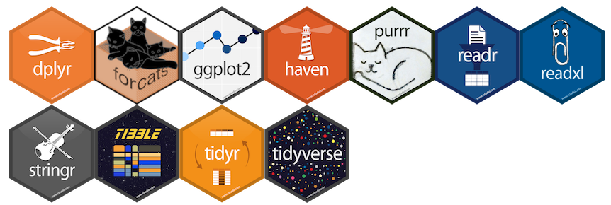
The tidyverse
In R, tidy data principles are the foundation of a series of packages by Hadley Wickham, built specifically for efficient data wrangling and analysis
The ‘tidyverse’
http://hadley.nz/ and http://tidyverse.org/

Slide 16

Introduction to tidy data work
https://r4ds.had.co.nz/

Slide 17
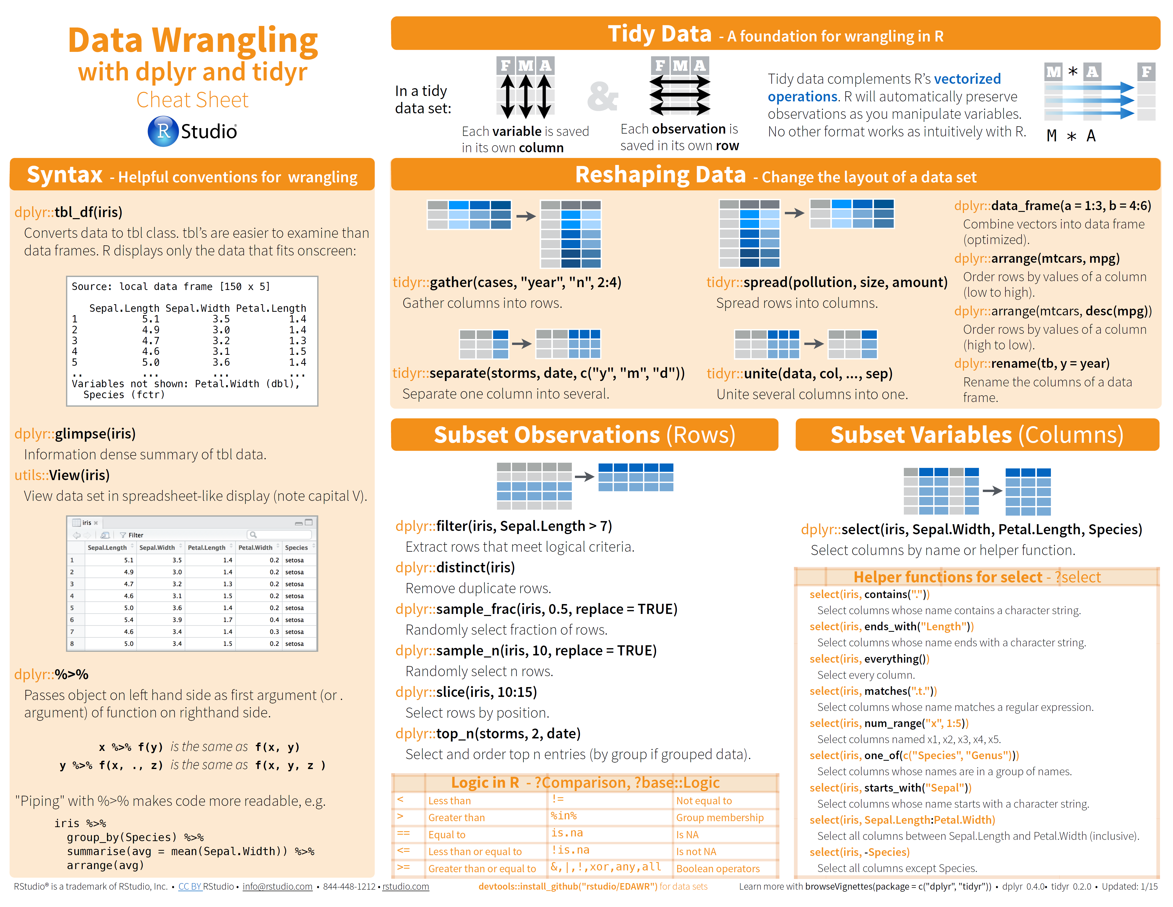
Tidy data tools in R
http://www.rstudio.com/wp-content/uploads/2015/02/data-wrangling-cheatsheet.pdf

Slide 18
Tidy data tools in R
https://s3.amazonaws.com/assets.datacamp.com/blog_assets/Tidyverse+Cheat+Sheet.pdf

Slide 19
Tidy data tools in R
In the Tidyverse, you’ll note that all packages function together seamlessly
Many of the core commands have counterparts in SQL (e.g., select) and so are intuitive and transferable
Typically the tidyverse commands will have the form: command(data, optional variables)

Slide 20
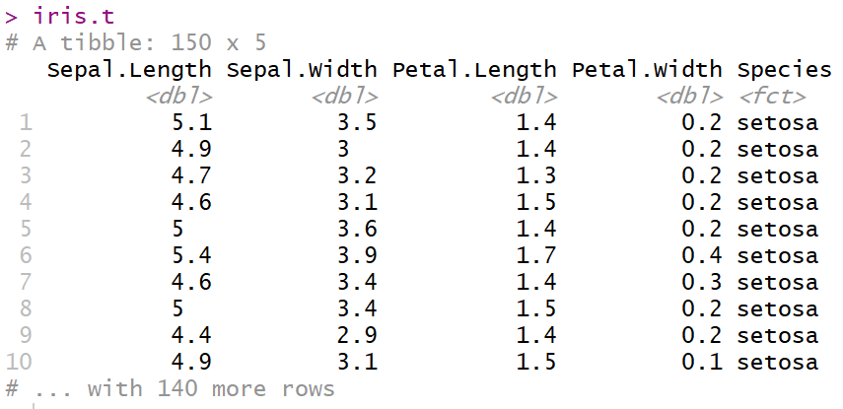
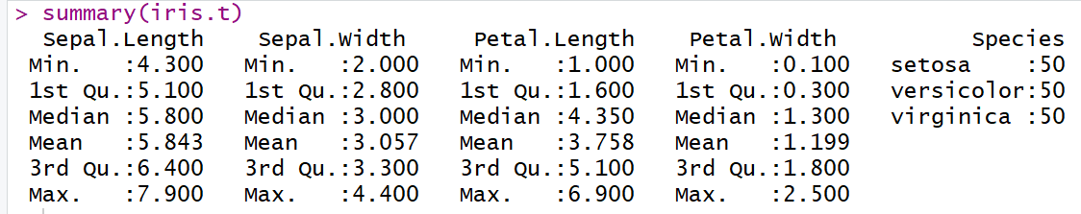
Example dataset iris.t

Slide 21
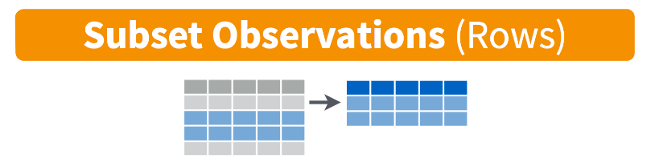
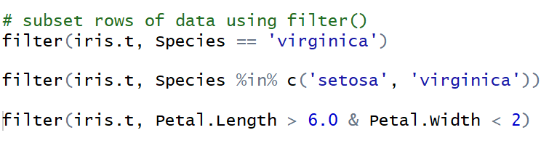
Tidy data using dplyr
filter()

Slide 22
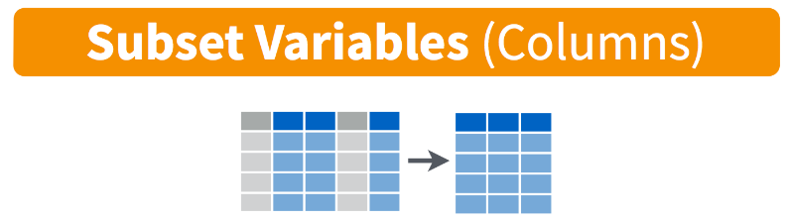
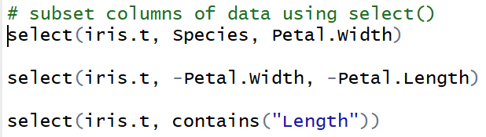
Tidy data using dplyr
select()

Slide 23
Tidy data using dplyr

Slide 24
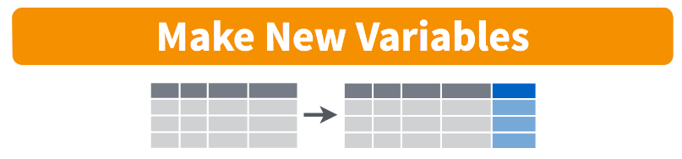
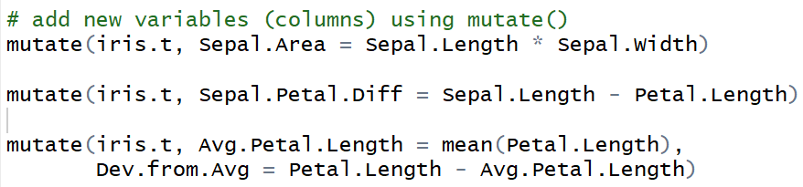
Tidy data using dplyr
mutate()

Slide 25

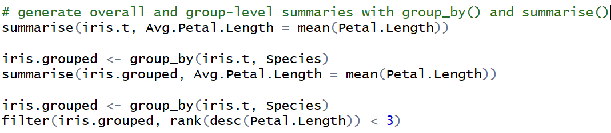
Tidy data using dplyr
group_by() and summarise()

Slide 26
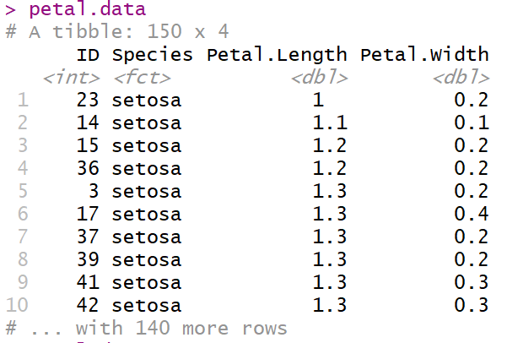
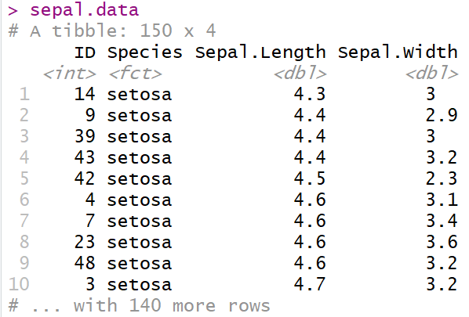
Tidy data using dplyr
left_join(), inner_join()and full_join()

Slide 27
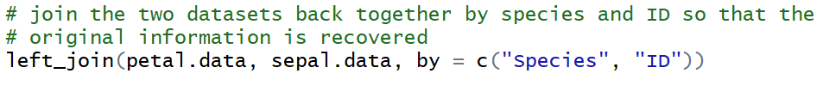
Tidy data using dplyr
left_join(), inner_join()and full_join()

Slide 28
Tidy data using dplyr
For more details see: http://stat545.com/bit001_dplyr-cheatsheet.html

Slide 29
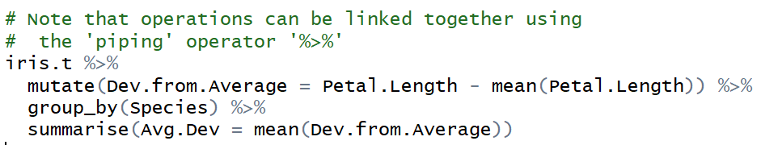
Piping
In multi-step data manipulation, tidy data tools provide a convenient way to link individual operations together into a single block of code

Slide 30
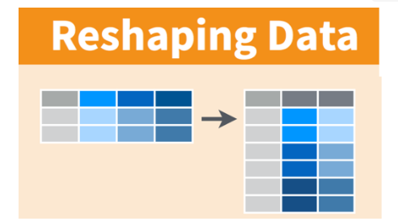
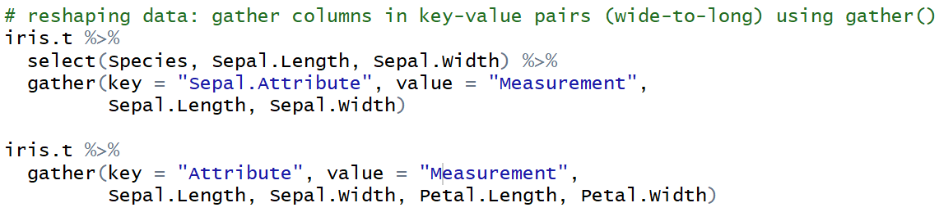
Tidy data using tidyr
Wide-to-long format: gather(key=, value=)

Slide 31
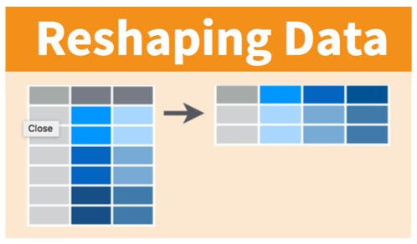
Tidy data using tidyr
Long-to-wide format: spread(key=, value=)

Slide 32
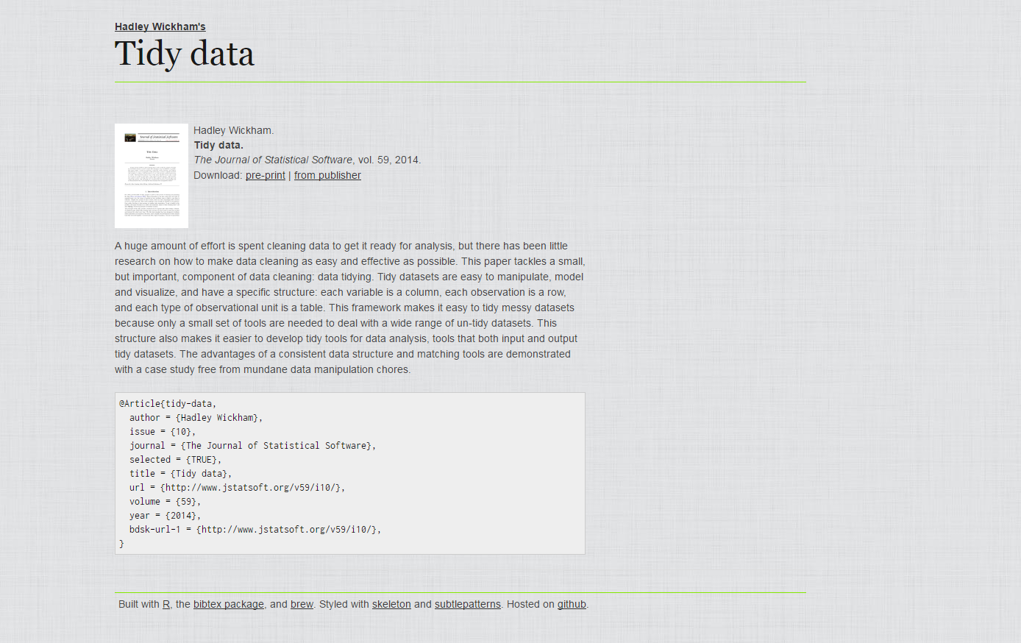
Getting started – tidy data paper
http://vita.had.co.nz/papers/tidy-data.html

Slide 33
Getting started – some resources
https://r4ds.had.co.nz/
https://www.r-bloggers.com/hadley-wickhams-dplyr-tutorial-at-user-2014-part-1/
https://www.r-bloggers.com/hadley-wickhams-dplyr-tutorial-at-user-2014-part-2/
https://www.rstudio.com/resources/cheatsheets/
https://github.com/rstudio/cheatsheets/blob/master/data-transformation.pdf
https://github.com/rstudio/cheatsheets/blob/master/data-import.pdf
http://jules32.github.io/2016-07-12-Oxford/dplyr_tidyr/#
https://rstudio-pubs-static.s3.amazonaws.com/109948_876c577ae6424d47b529fce960db7bf4.html#1

